Slide 1
The Drift Diusion Simulation of Coupled Ionic-Electronic Devices
By: Cem Bonfil

Slide 2
Overview
What is an ionic electronic device ?
Equations
Application of Finite Difference
Memristor
1-D and 2-D Memristor Simulations
2-D Simulation vs. Experimental Results
Conclusion

Slide 3
1-What is an ionic electronic device ?
Electrical behavior determined by the movement of mobile charged particles
Ions, holes and electrons
Natural: Ionic-channels in organic membranes
Engineered: Non-Volatile Memory, Organic FET, Memristor
Easy to fabricate, low operating voltage, slow

Slide 4



2- General Equations
Drift diffusion equation:
Continuity Equation:
Poisson’s Equation:

Slide 5
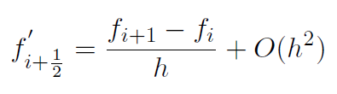


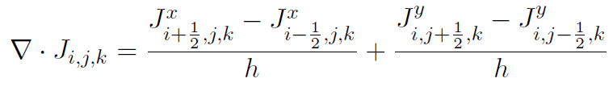

3. Application of Finite Difference
First Order Central Difference :
Second Order Central Difference:
Current Density
Continuity
Poisson’s Equation

Slide 6
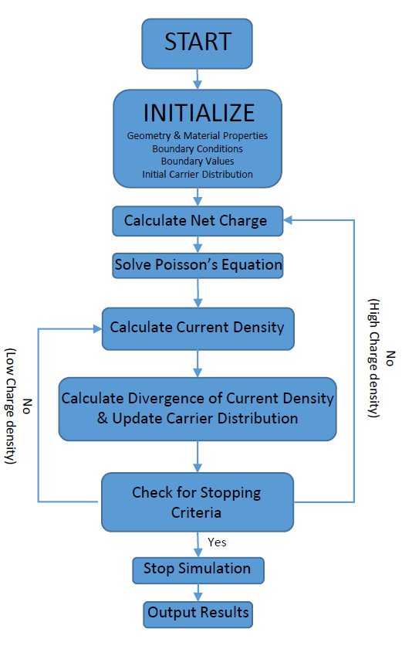
3.1- Solution Process
Figure 1: Finite Difference Drift Diffusion Solver Flowchart

Slide 7
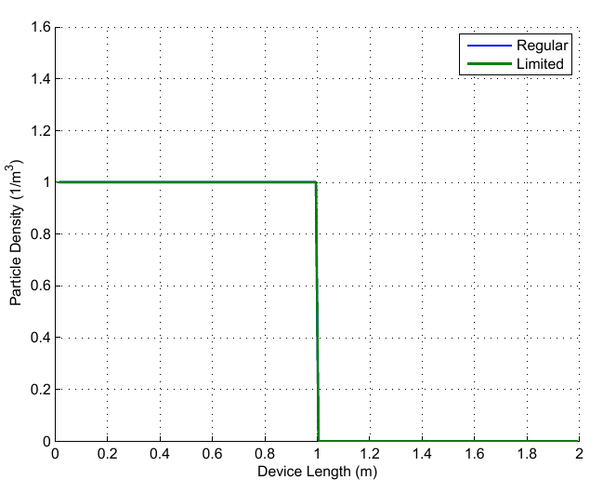
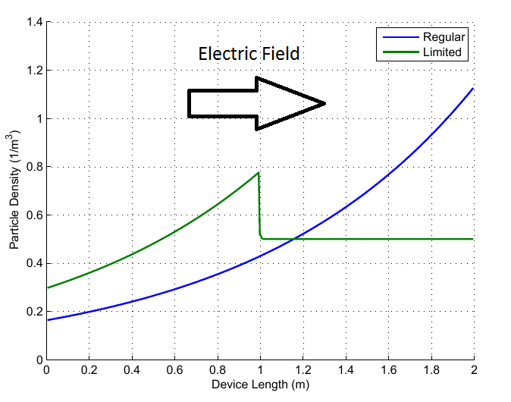
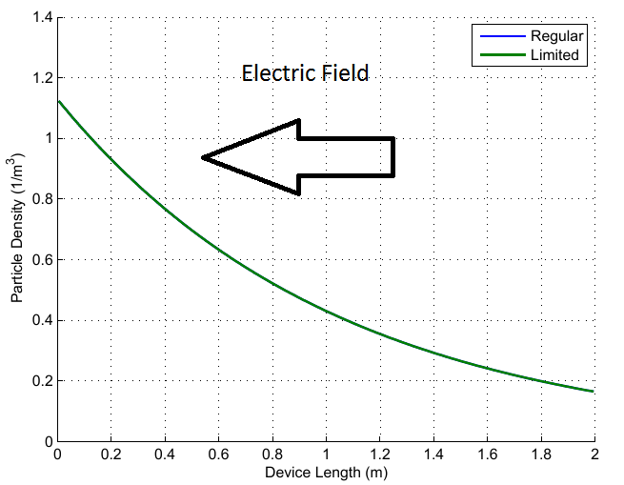
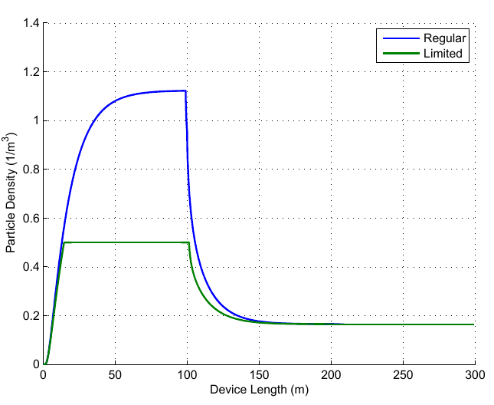
3.2- Current Limiting Mechanism
Pre calculate the next time step
Check for saturation
Set influx to zero (saturation)
Do nothing (no saturation)
Update carrier densities
Figure 2: Initial particle density
Figure 3: Density accumulation (right wall)
Figure 4: Density accumulation (right wall)
Figure 5: Density accumulation over time

Slide 8
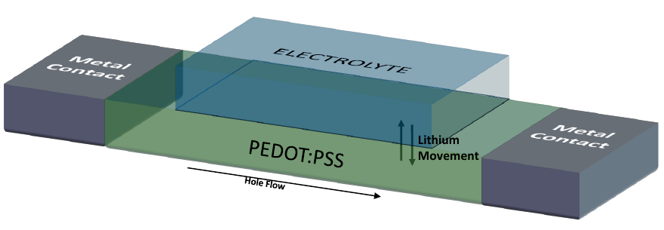
4- Memristor
Voltage controlled resistor with memory
Equation: M(q(t)) = V(t)/I(t)
2 Distinct types
Organic: Based on PEDOT:PSS….
Inorganic: Based on TiO2
Figure 6: An organic memristor with electrolyte and PEDOT:PSS (not to scale)

Slide 9
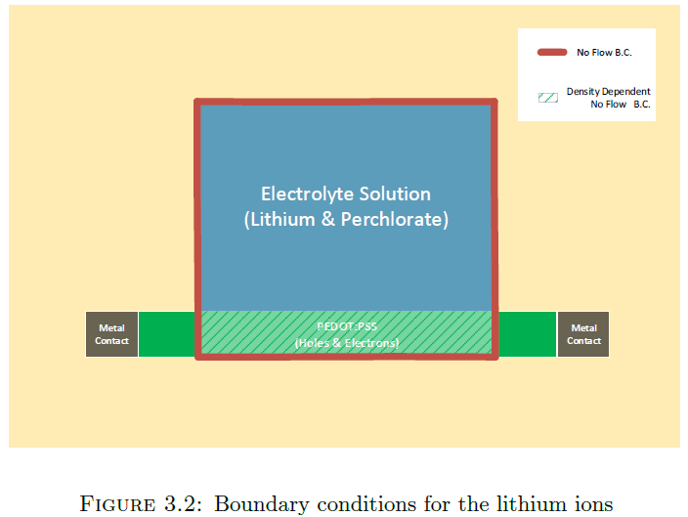
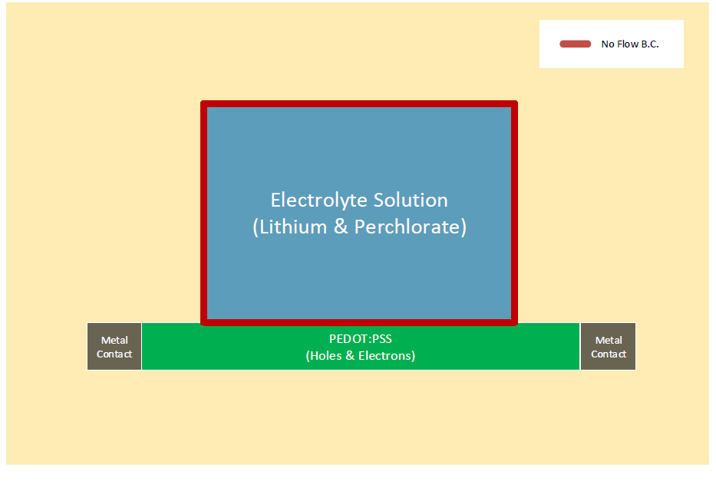
4.2- BoundarY conditions
Figure 7: Boundary condition for lithium ions
Figure 8: Boundary condition for perchlorate ions

Slide 10
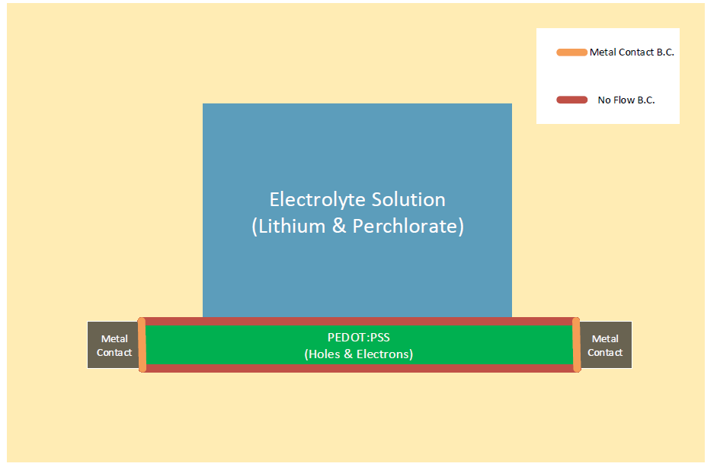
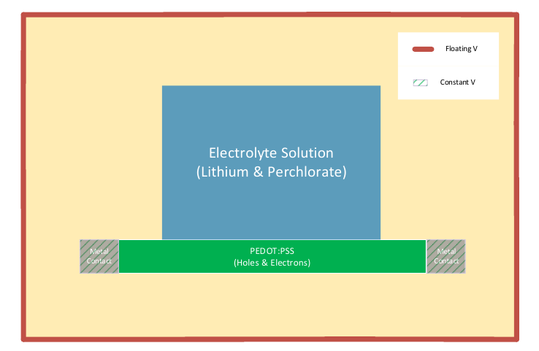
4.2- BoundarY conditions
Figure 9: Boundary condition for holes
Figure 10: Boundary condition for electric potential
Notes:
Add E,V Boundary conditions

Slide 11
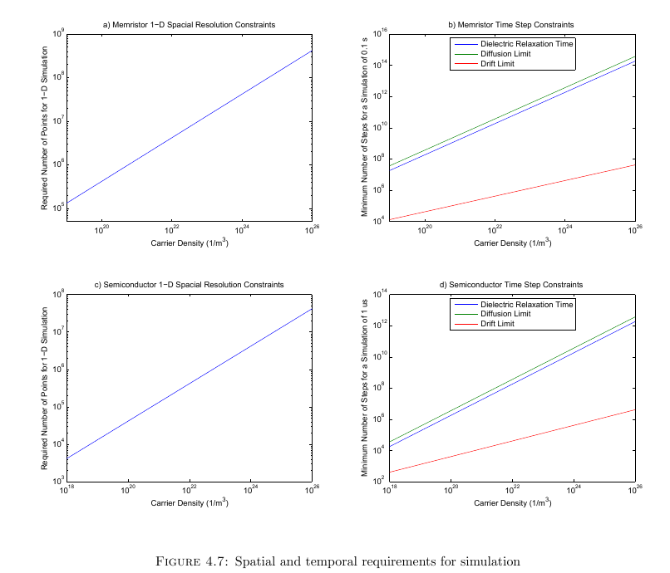
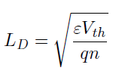



4.3- Numerical and Physical Limitations
Debye Length:
Dielectric Relaxation Time:
CFL Conditions
Drift
Diffusion:
Figure 11: Spatial and temporal requirements for a simulation

Slide 12

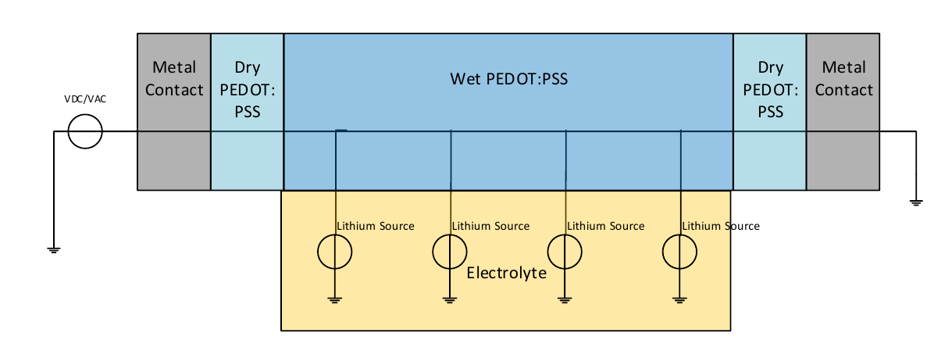


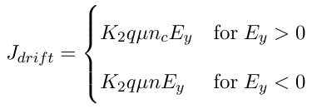
5- 1-D and 2-d memristor Simulations
Diffusion Current :
Electric Potential:
Electric Field:
Drift Current:
Figure 12: 1-D Memristor Model

Slide 13
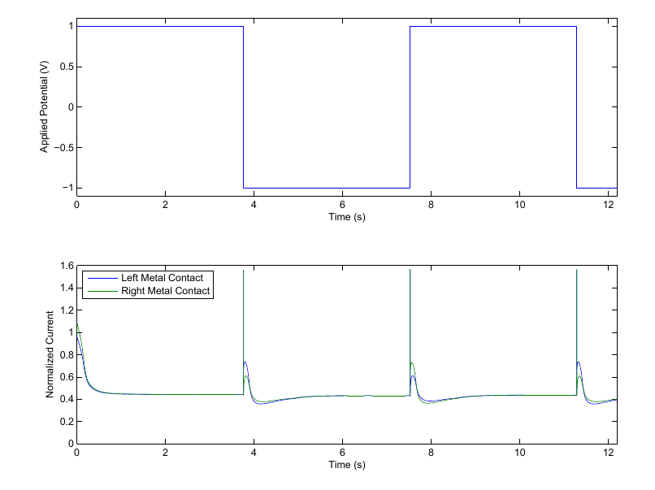
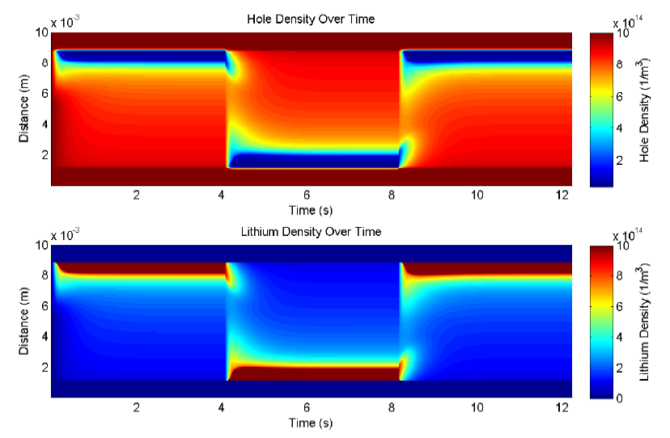
5.1 – 1-D Memristor Simulation
Figure 13: Current density over time for a potential pulse train
Figure 14: Lithium and hole density distribution over time
Notes:
Potential pulse train: Current Output, Lithium, hole density, Efield ?

Slide 14
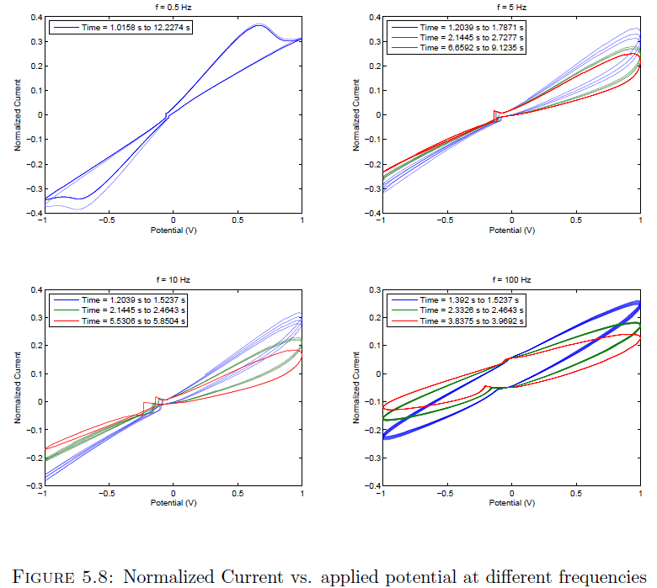
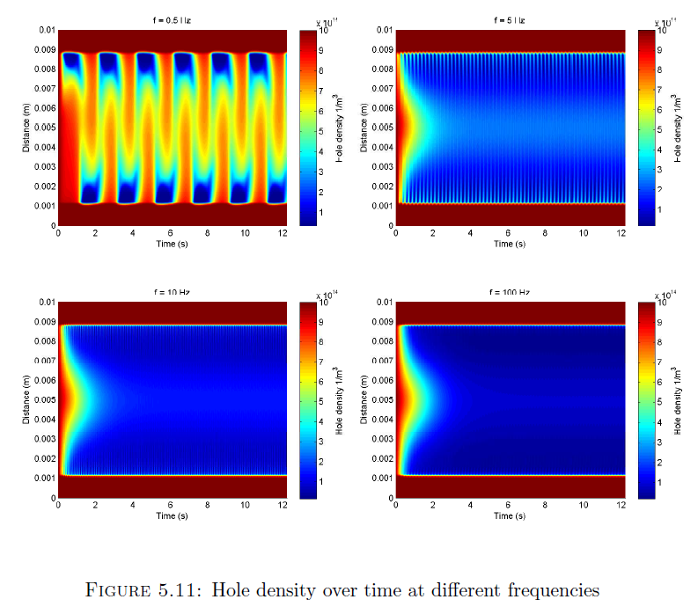
5.1 – 1-D Memristor Simulation cont.
Figure 15: Normalized current vs. applied potential at different frequencies
Figure 16: Lithium and hole density distribution over time

Slide 15
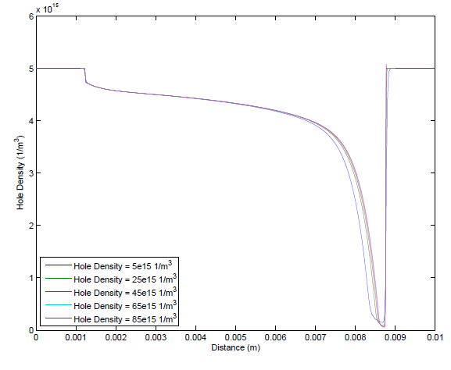
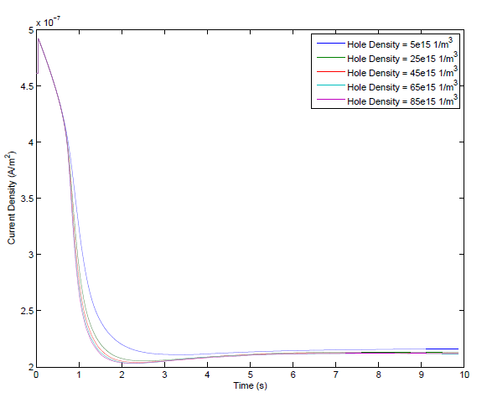
5.2- Scaling to Higher densities
Figure 17: Normalized hole densities at steady state
Figure 18: Normalized current densities

Slide 16
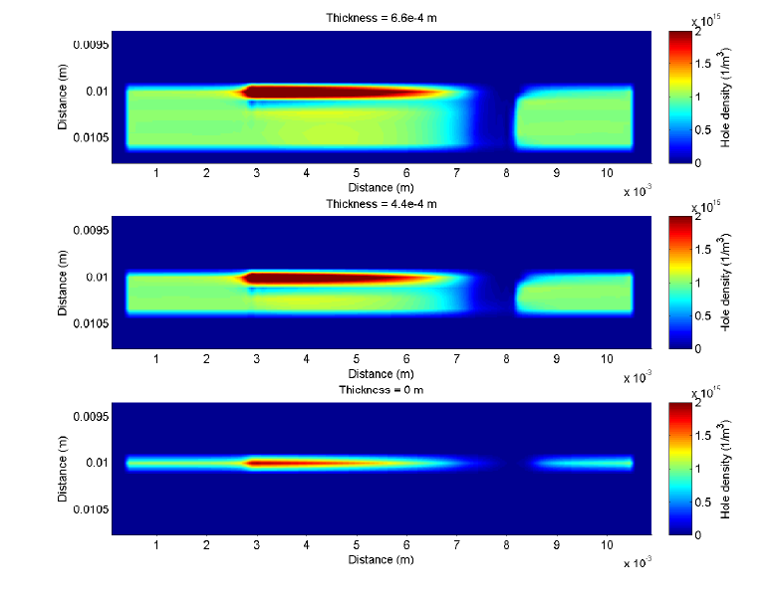
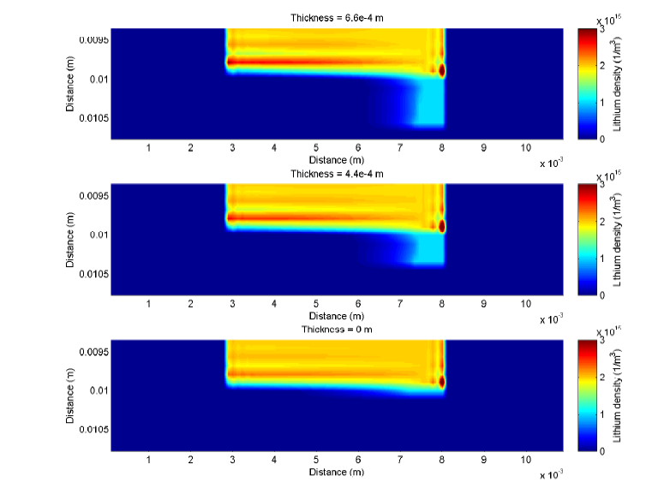
5.3- 2-D Memristor Simulations
Figure 19: Hole distribution at steady state for different PEDOT:PSS thicknesses
Figure 20: Lithium distribution at steady state for different PEDOT:PSS thicknesses

Slide 17
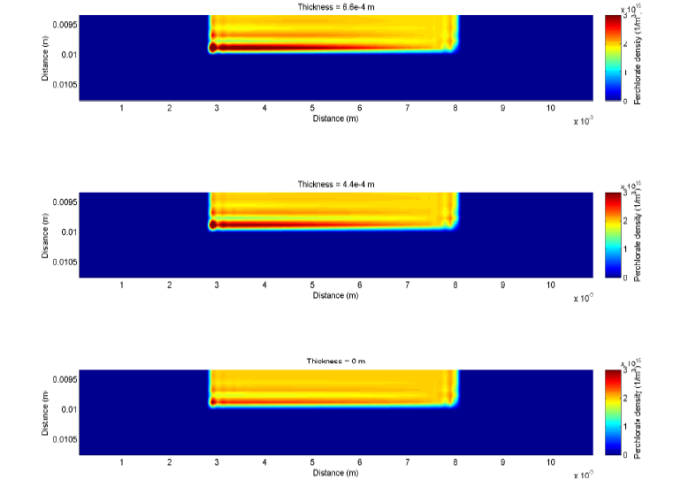
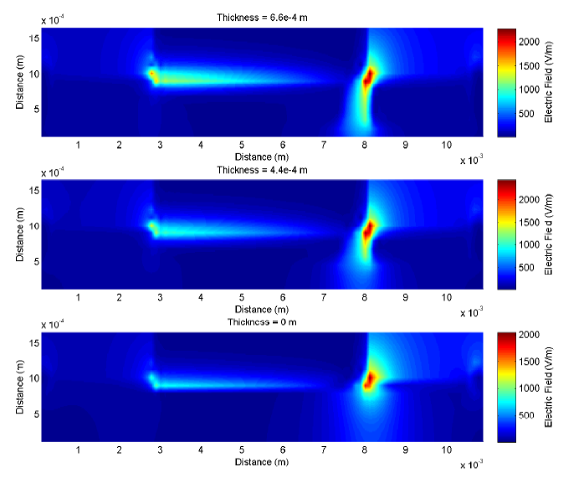
5.3- 2-D Memristor Simulations
Figure 21: Perchlorate distribution at steady state for different PEDOT:PSS thicknesses
Figure 22: Electric field strength distribution at steady state for different PEDOT:PSS thicknesses

Slide 18
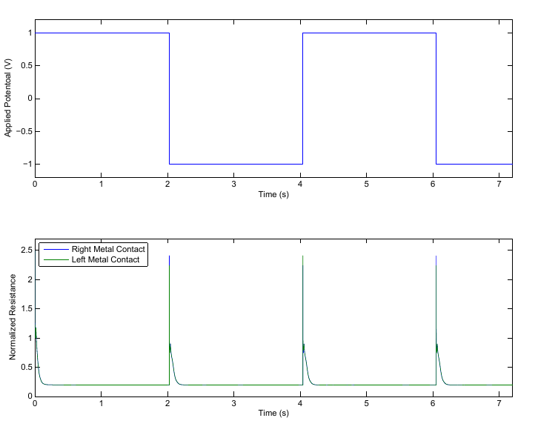
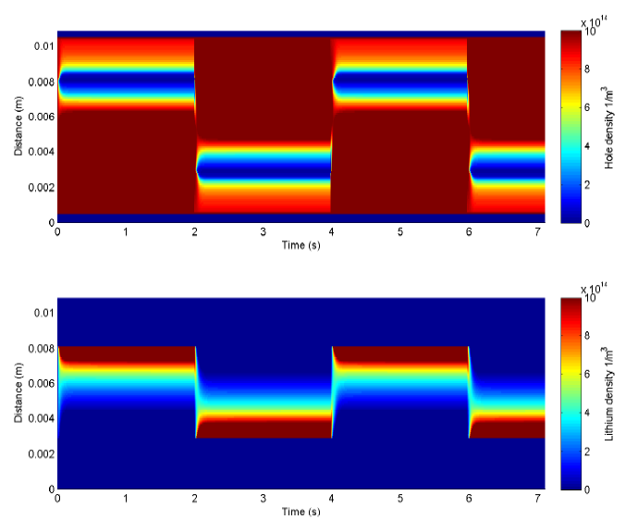
5.3- 2-D Memristor Simulations
Figure 23: Current density over time for a potential pulse train
Figure 24: Lithium and hole density distribution over time
Notes:
Potential pulse train: Current Output, Lithium, perchlorate and hole density, Efield ?

Slide 19
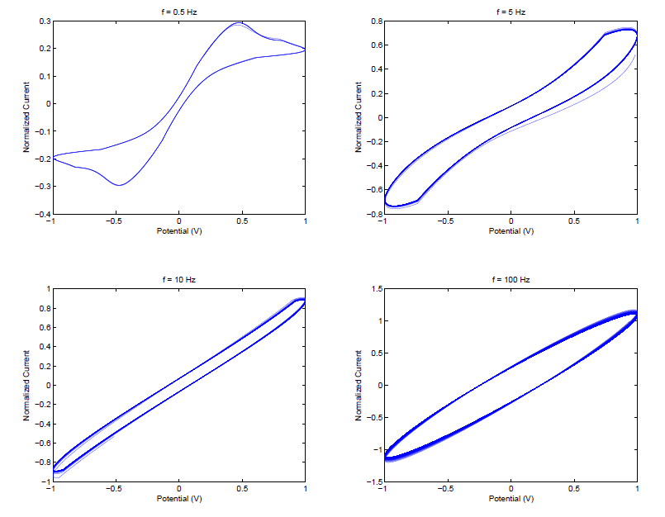
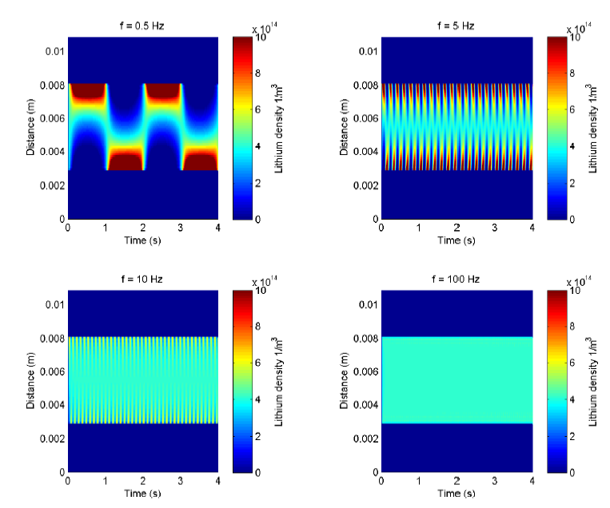
5.3- 2-D Memristor model cont.
Figure 25: Normalized current vs. applied potential at different frequencies
Figure 26: Lithium and hole density distribution over time
Notes:
Sinusoid: Current Output, Lithium, perchlorate and hole density, Efield ?

Slide 20
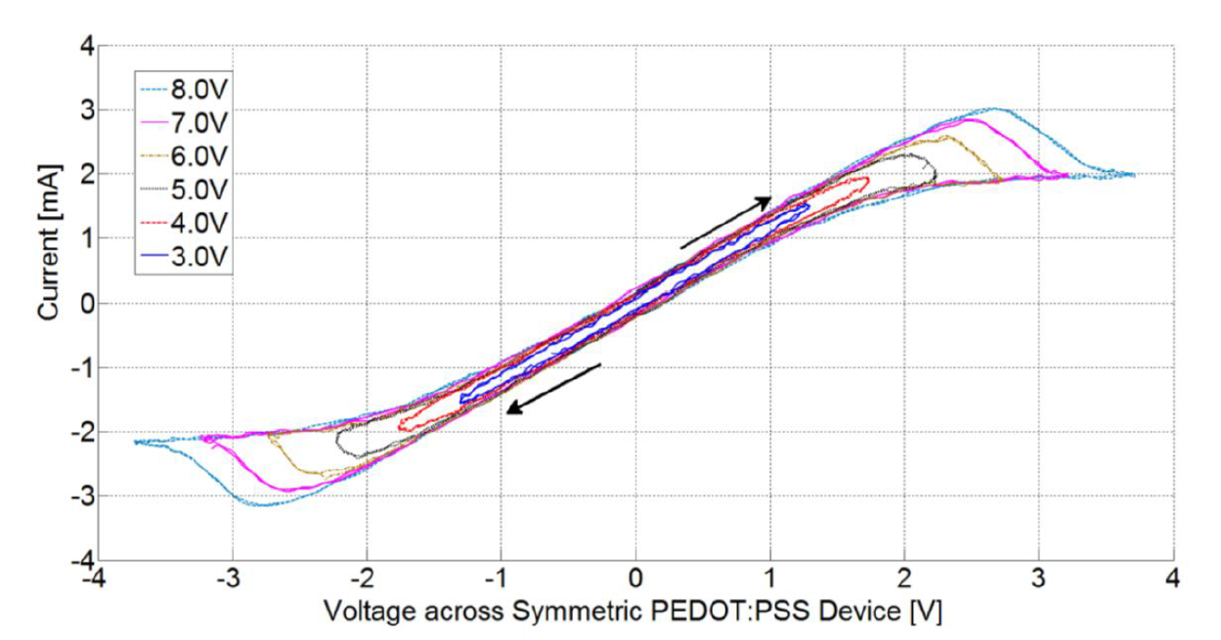
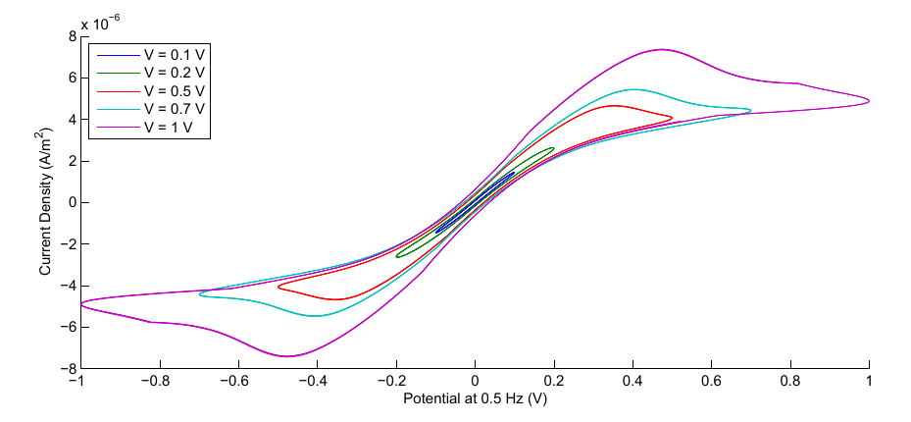
6. 2-D simulation vs. experimental results
Figure 27: Experimental results for various applied potentials at 1.0 Hz (Courtesy of Eduardo Barrera)
Figure 28: Simulation results for various applied potentials at 1.0 Hz

Slide 21
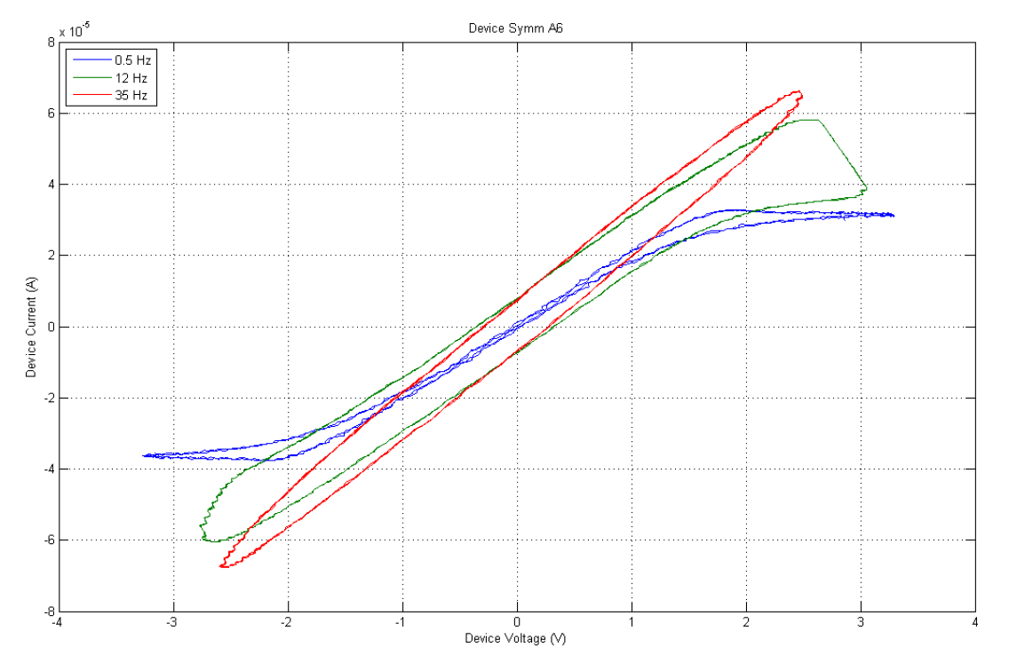
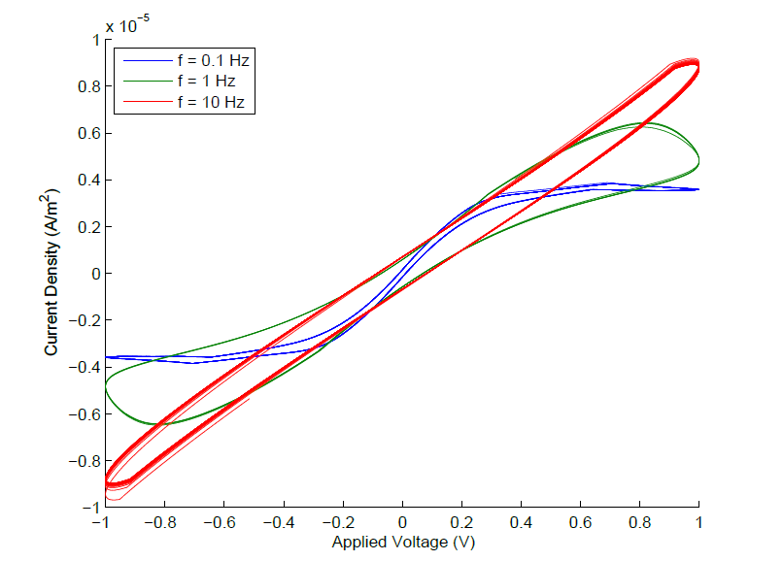
6. 2-D simulation vs. experimental results Cont.
Figure 29: Measured I-V curve at different frequencies (Courtesy of Eduardo Barrera)
Figure 30: Measured I-V curve at different frequencies

Slide 22
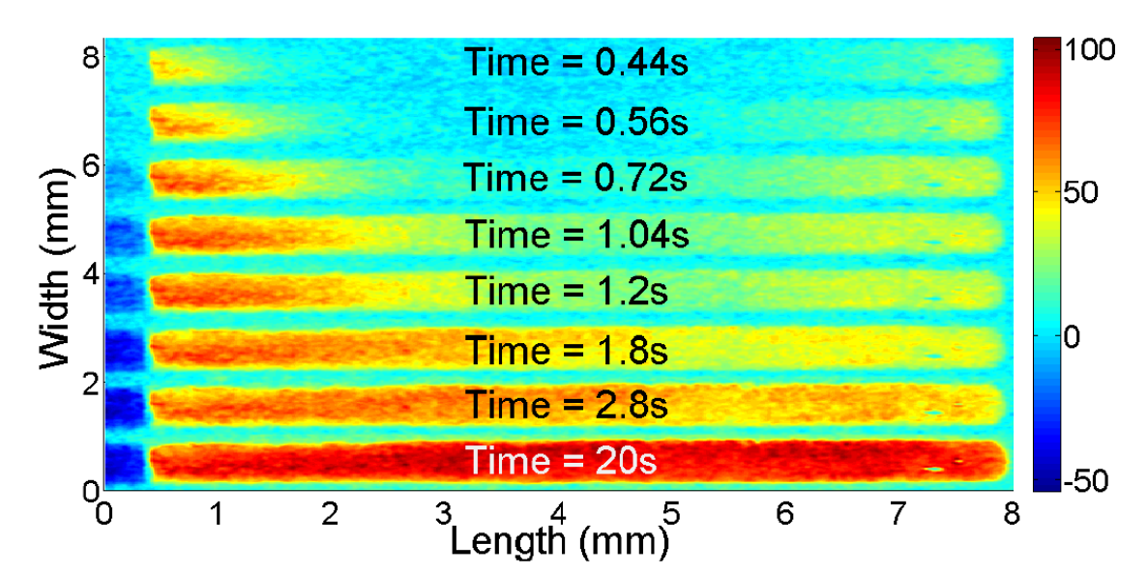
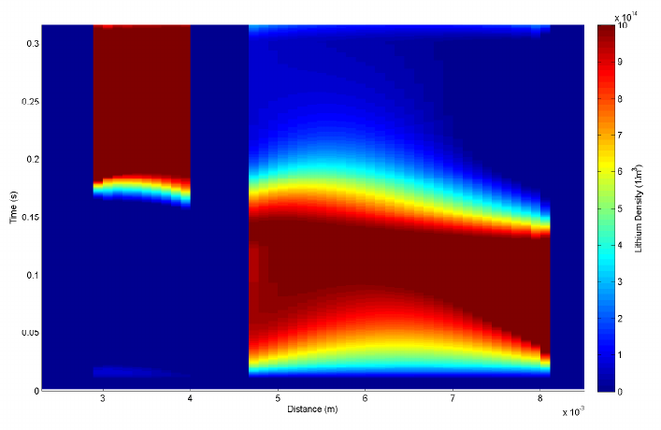
6. 2-D simulation vs. experimental results Cont.
Figure 31: Experimental results for accumulation of lithium inside PEDOT:PSS (Courtesy of Eduardo Barrera)
Figure 32: Simulation results for accumulation of lithium inside PEDOT:PSS

Slide 23
7- Conclusion
Simulation of a ionic electronic device
Density Limiting Mechanism
Density scaling issues, parameter fitting
Additional modeling of hole transport mechanisms
Different Geometries
Further experimental verification
3D Modelling

Slide 24
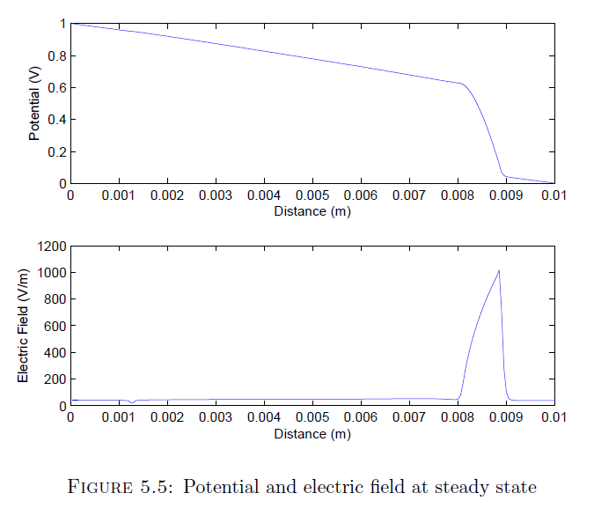
Electric Field

Slide 25
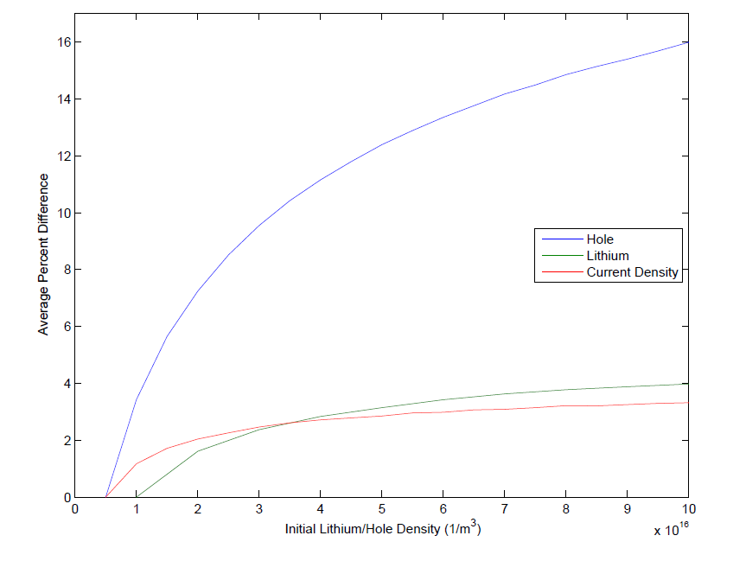
Percentage Difference

